Slide 1
BTRC

Slide 2

Presented by:
Name: Sheikh Nafez Sadnan
ID: 20101106
Course Code: CSE 407
Course Title: ICT Law, Policy & Ethics
Presented to:
Md. Lokman Hussain
Assistant Professor
Department of Law & Human Rights
University of Asia Pacific

Slide 3

WHAT IS BTRC?
The Bangladesh Telecommunication Regulatory Commission (BTRC) is an independent commission established under the Bangladesh Telecommunication Act, 2001. The BTRC is responsible for regulating all matters related to telecommunications, including wire, cellular, satellite, and cable communications in Bangladesh. The commission began its operations on January 31, 2002. It is located at Plot: E-5/A, Agargaon Administrative Area, Sher-E-Bangla Nagar, Dhaka-1207.

Slide 4
STRUCTURE
The Bangladesh Telecommunication Regulatory Commission (BTRC) is structured with a chairman at the helm. The chairman of the commission has the status of a judge of the Bangladesh High Court. The current chairman is Shyam Sunder Sikder. The BTRC has had several chairmen since its inception. Here are some of them along with their terms:
Syed Margub Murshed (31 January 2002 - 30 January 2005)
Muhammad Omar Farooq (31 March 2005 - 15 March 2007)
Major General Manzurul Alam (22 April 2007 - 10 February 2009)
Major General Zia Ahmed (26 February 2009 - 10 September 2012)
Md. Giashuddin Ahmed (10 September 2012 - 22 October 2012)
Sunil Kanti Bose (23 October 2012 - 23 September 2015)
Shahjahan Mahmood (24 September 2015 - 1 September 2018)
Md Jahurul Haque (31 January 2019 - 4 December 2020)
Shyam Sunder Sikder (14 December 2020 - Present)

Slide 5
DEPARTMENTS
Administration Department
Finance, Accounts and Revenue Department
Legal and Licensing Department
Engineering and Operations Department
Spectrum Department
Systems and Services Department
Enforcement and Inspection Directorate
Commission Secretariat
Media Communication and Publication Wing:

Slide 6
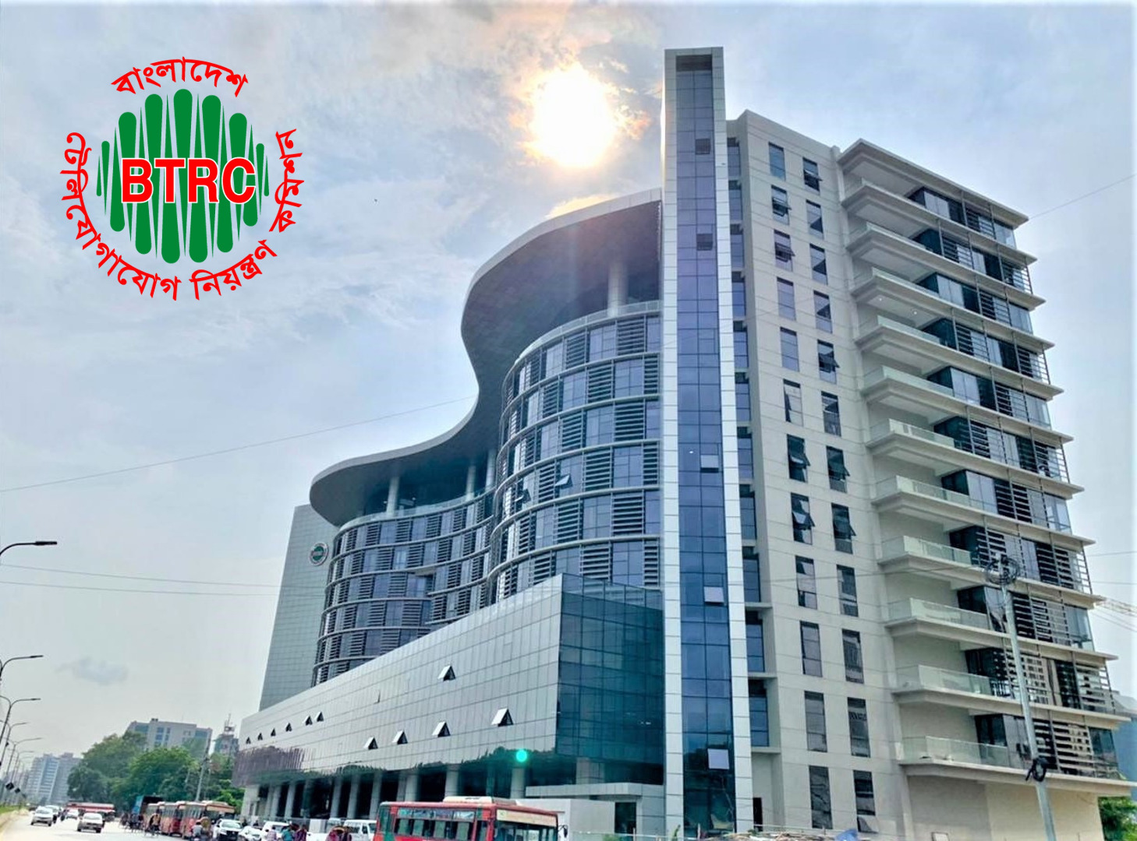
LAW & POLICY
Telecommunications Act 2001
Law:
Telegraph Act 1885
Wireless Telegraph Act 1933
Telecommunications Act 2001
Policy:
Telecom Policy 1998
ICT Policy
:

Slide 7


SERVICES PROVIDED BY BTRC
Telecommunications Act 2001
Regulation of Telecommunication Services
Licensing
Value-Added Services (VAS)
Consumer Complaints Handling
Quality of Service (QoS) Standards
Reporting and Record Keeping

Slide 8


SERVICES PROVIDED BY BTRC (cont.)
Telecommunications Act 2001
Telecommunication System Development
Access to Services
Prevention of Discrimination
Encouragement of New Services
Short Code Services

Slide 9
Thanks!
20101106@uap-bd.edu

